Slide 1

MOVie Recommendation
MANIKANDAN C

Slide 2
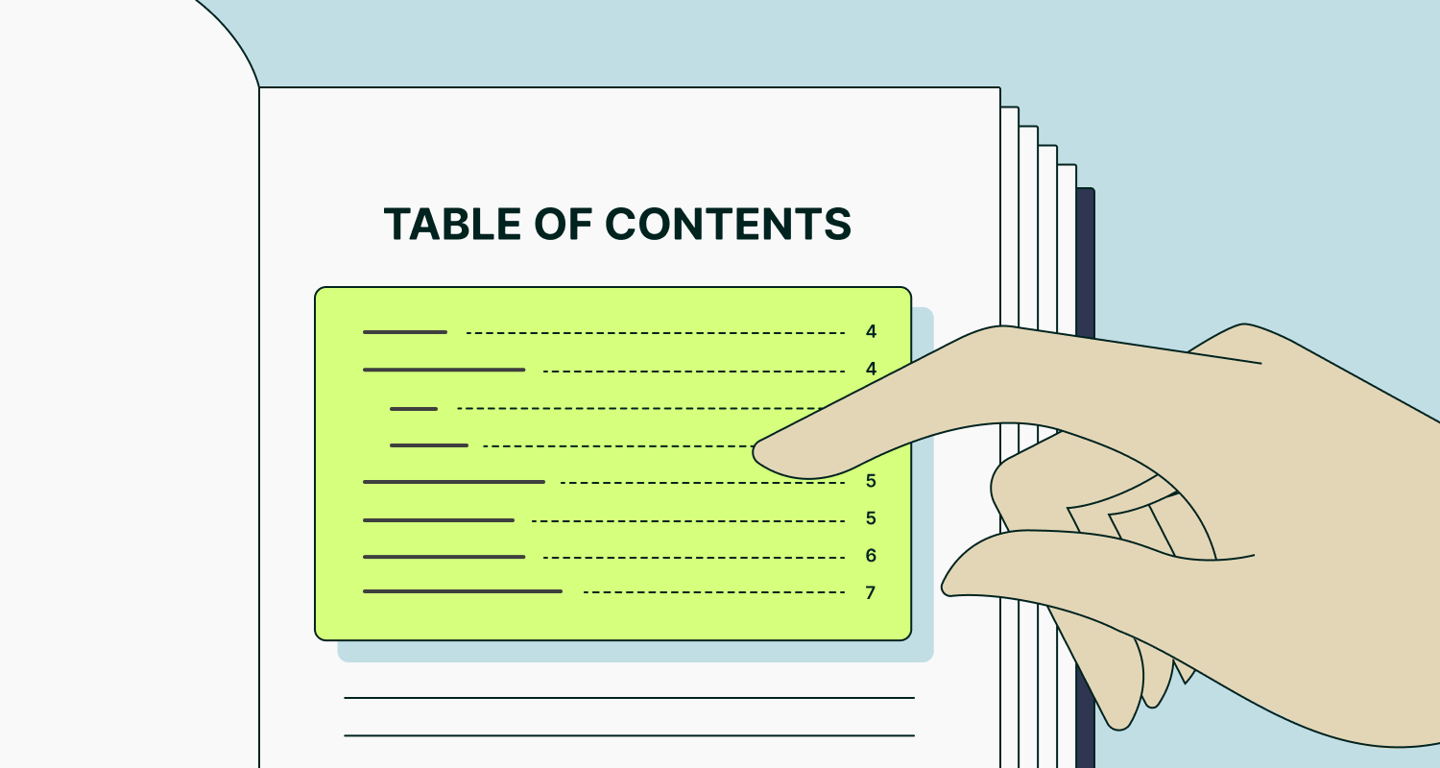
Topics
1.PROBLEM STATEMENT
2.PROPOSED SOLUTION
3.FEATURES
4.HIGH LEVEL DESIGN
5.CONCLUSION

Slide 3
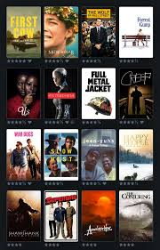
Problem STATEMENT
With the vast number of movies available across various platforms, users often face challenges in selecting films that match their interests. A personalized movie recommendation system is needed to enhance user experience by suggesting movies based on preferences, viewing history, and ratings.

Slide 4
Features current & future
Movie Database
Search and Filter
A comprehensive database of movies, including details like genre, cast, director, and user ratings.
Users can search for movies and filter results based on genre, release year, and ratings.
Theatre predict
CHATBOT
User Authentication:
Rating System
A theatre movie recommendation system uses algorithms to suggest films based on user preferences, popularity, and genre, predicting the best movies to showcase each day.
n this chatbot, the main purpose is to show extra details about movies
Users can sign up, log in, and manage their profiles.
Users can rate movies, which will be used to generate recommendations.

Slide 5




TECh Stack
REACT
MONgodb
FLASK
Machine Learning
Algorithm
React is a JavaScript library for building user interfaces, enabling reusable components and efficient state management.
MongoDB is a flexible, scalable NoSQL database ideal for full-stack applications due to its JSON-like data format and high performance.
Flask is a lightweight Python web framework for building web applications, known for its simplicity and flexibility.
Machine learning algorithms for movie prediction in theaters involve various techniques

Slide 6

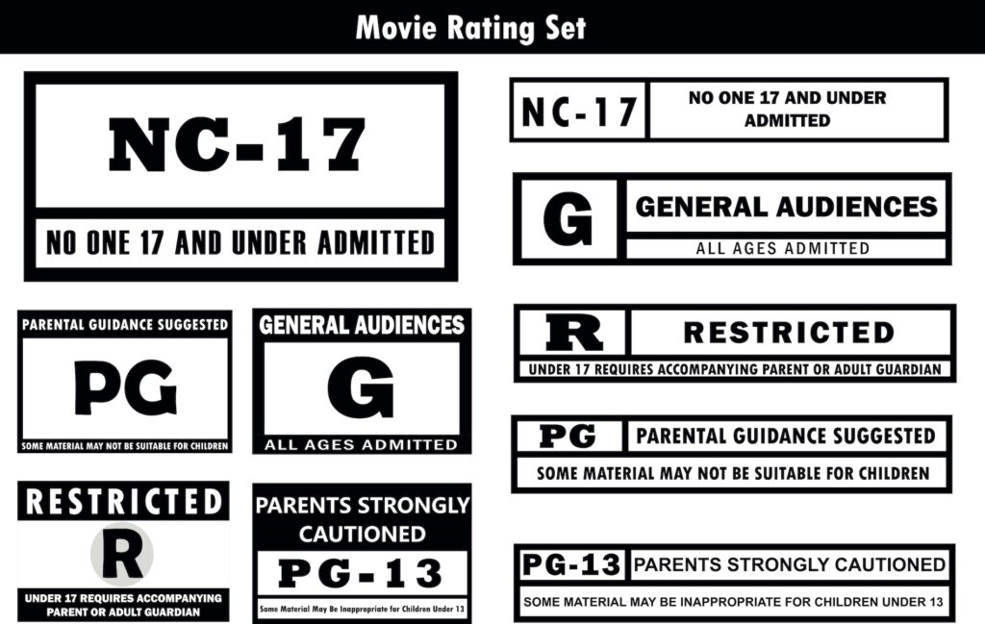




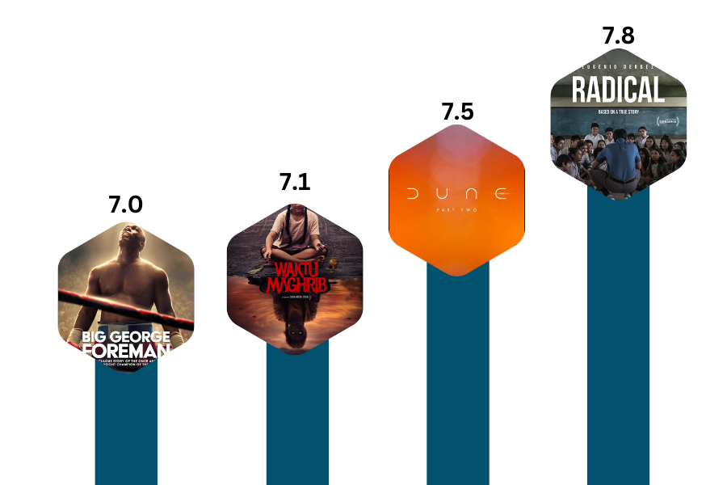


High level design for movie predict

Slide 7
CONCLUSION
3.Algorithm Utilization: It employs algorithms like collaborative filtering and content-based filtering to enhance recommendation accuracy.
Personalization: The system tailors film suggestions based on individual user preferences and viewing history.
2.User Discovery: The system helps users discover new movies they are likely to enjoy, improving their overall viewing experience.
4.Business Benefits: It optimizes film offerings for theaters and streaming services, ultimately increasing audience engagement and satisfaction.

